Slide 1

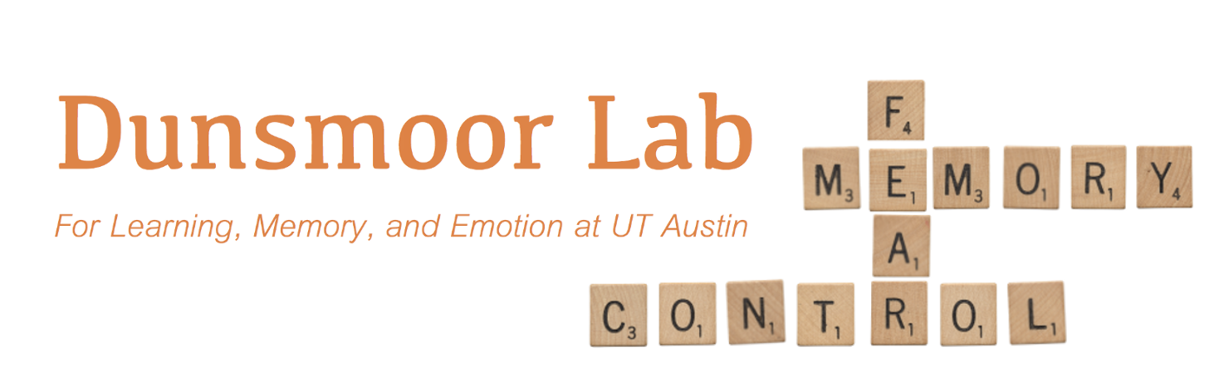
Dissociable neural reinstatement of emotional memories in human PFC
Augustin Hennings
Dunsmoor & Lewis-Peacock Labs
INS Dialogues 11/6/2020

Slide 2


Fear of dogs
Dogs are O.K.
Fear
Extinction
Fear often returns in novel contexts, or after a passage of time
Extinction is new learning, fear is not erased
How are these opposing associations organized in the brain?
Notes:
So I’m going to start day with something rather grim – lets say one day you are attacked by a dog. This negative experience could lead you to form a fear of all dogs, and this is a real world example of fear conditioning
A while later, you encounter a friendly dog, and you think hey ok dogs aren’t so bad. This is an example of fear extinction, and fear extinction serves as a laboratory model of exposure therapy, which is the most widely used treatment for trauma disorders
But we know that exposure therapy, or extinction, isn’t perfect – fear often returns in novel contexts, or after a passage of time. Since fear can return after extinction learning, extinction is then new learning which does not erase the original fear association.
Since both memories exist simultaneously, an adaptive memory system would segregate how these opposing associations are stored in the brain. What does this organization look like?
Rodent models have explored this question to great success, by looking for encoding specificity of these memories.

Slide 3
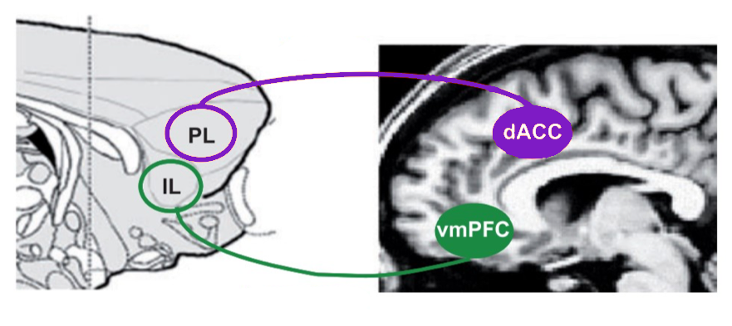


Encoding specificity - the neural circuits which encode a memory reactivate during retrieval
Fear and extinction engrams are stable and separable, in rodents
Fear
Extinction
Univariate approaches, no evidence of neural reinstatement in humans
Milad & Quirk, 2012, Annu Rev Psychol
Notes:
Encoding specificity is the process in which the neural circuits which encode a memory reactivate during retrieval.
Rodent work has shown that fear and extinction memories exist as stable and separable engrams that are reinstated to guide behavior. That is, there are distinct neural populations that are active during both encoding and retrieval of these associations.
From this work, we know that different regions of the rodent prefrontal cortex store engrams of opposite valence.
Specifically, fear engrams have been observed in the prelimbic cortex, and extinction engrams has been observed in the infralimbic cortex.
On the human side of things, there is converging evidence that the homologue structures, dorsal anterior cingulate cortex and the ventromedial prefrontal cortex, also code for memories of opposite value.
However most of this work in humans has only used univariate measures, and has not looked for evidence of neural reinstatement, or engram like-activity, across these two regions.

Slide 4
Are associative emotional memories organized the same way in humans as in rodents?
-Goal-
Identify separable neural reinstatement of fear and extinction across the PFC
Heathy
Fear
dACC
vmPFC
Neural Reinstatement
Extinction
Fear
Extinction
Fear
Extinction
Notes:
So the main question we are asking here, is are associative emotional memories organized the same way in humans there are in rodents? Can we show encoding specificity of these associations,
So the goal of this project is to identify separable neural reinstatement of fear and extinction across the human PFC
This leads us to our specific hypothesis – due to the functional separation in affective processing in the PFC, we predicted that there will be a double dissociation of emotional memory reinstatement. FULL STOP.
Specifically, we predict that fear memories are preferentially reinstated in the dACC, and extinction memories are preferentially reinstated in the vmPFC.
With more words transition from healthy prediction to PTSD prediction

Slide 5
Are associative emotional memories organized the same way in humans as in rodents?
-Goal-
Identify separable neural reinstatement of fear and extinction across the PFC
Heathy
PTSD
dACC
vmPFC
dACC
vmPFC
Is reinstatement dysregulated in individuals with PTSD?
?
Neural Reinstatement
Neural Reinstatement
Fear
Fear
Fear
Fear
Extinction
Extinction
Extinction
Extinction
Notes:
Now this is for healthy adults. What about individuals with PTSD? We know that PTSD is characterized by an inability to retrieve safety or extinction memories, and instead show enhanced return of fear
So one possibility is that individuals with PTSD will show dysregulated extinction reinstatement. But were really not sure what to expect.

Slide 6


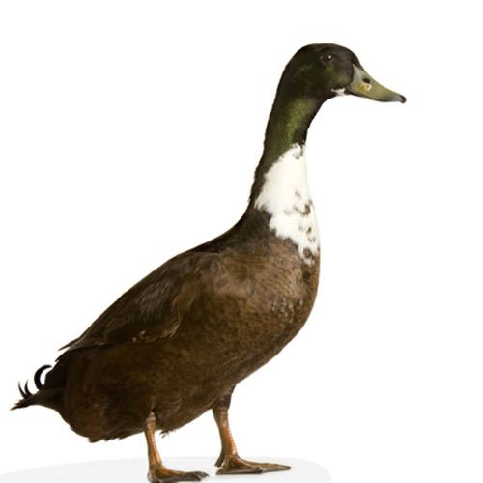
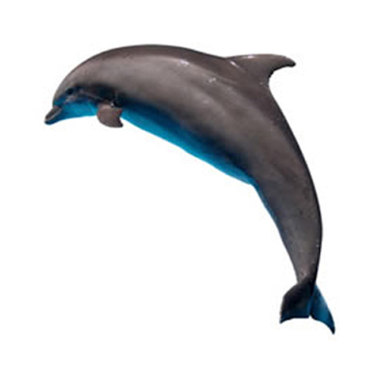


Category conditioning
Dunsmoor & Kroes, 2019, Curr Opin Behav Sci
Animals and Tools are conditioned stimuli (CS)
N = 24 healthy participants
N = 24 PTSD symptom individuals
Each unique episodic memory item is encoded with one emotional association
24hrs
Pre-acquisition
Fear acquisition
Extinction
Surprise Recognition
Memory Test
CS+, Animals
CS-
CS+
CS-, Tools
…
CS+
…
CS-
…
Def Old
Def New
Maybe Old
Maybe New
Specific category exemplars are never repeated
Notes:
That brings us to our methods
In order to test our hypotheses, we employed an episodic-associative hybrid task.
In this task, participants form an emotional association to an entire sematic category, either animals or tools.
Each individual stimulus used is a unique category exemplar, that is not repeated. For example, even though they may see many different kinds of animals, there is only 1 dog shown during the entire experiment.
All phases of this task are done inside the scanner. The task starts with a pre-fear acquisition or baseline phase, in which participants are passively viewing the stimuli. Next, during fear acquisition, images from one category are paired with a mild electric shock to the wrist. 50% CS+US reinforcement. Extinction then immediately following fear acquisition, during which no shocks are delivered.
The following day, participants are placed back in the scanner and complete a surprise recognition memory test for the items they saw the previous day.
The end result of this task is that each episodic memory, or category exemplar, has 1 implicit emotional association (none, fear, or safety). That is, each stimulus is encoded in a distinct emotional context, based on the type of associative learning taking place.
So in this case, even though the dolphin and duck are both animals, one is associated with fear acquisition, and one is associated with extinction.
We collected data for 24 healthy participants, and 24 individuals with PTSD symptoms

Slide 7
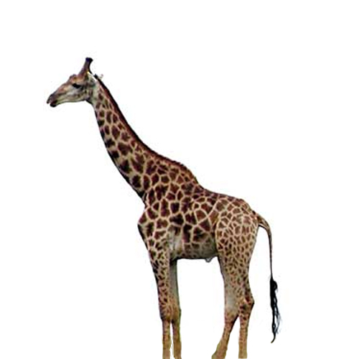
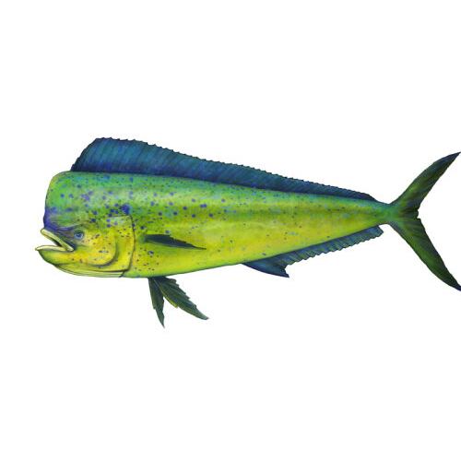

Encoding-Retrieval Similarity (ERS)
Correlation of neural activity from encoding to retrieval
Encoding
-24hrs-
Retrieval
Baseline
Baseline
Acquisition
Acquisition
Extinction
Extinction
Neural Activity
Low
High
Notes:
In order to measure neural reinstatement in humans, we use encoding-retrieval similarity, which is the correlation of neural activity from memory encoding to memory retrieval. Let me walk you through this.
During memory encoding, each item elicits a multivoxel pattern of activity. The next day, during the surprise memory test, each item again has its own unique pattern of activity. we can enter all of these patterns into a representational similarity matrix

Slide 8
Representational similarity matrix
Encoding
-24hrs-
Retrieval
Baseline
Pearson’s r
Baseline
Weak
Strong
Acquisition
Acquisition
Extinction
Extinction
Neural Activity
Low
High
Notes:
Here, each square represents the correlation of patterns of activity of different items, and from different time points.
What we are interested in is the correlation of same items to same items, for example dog to dog, from encoding to retrieval.

Slide 9
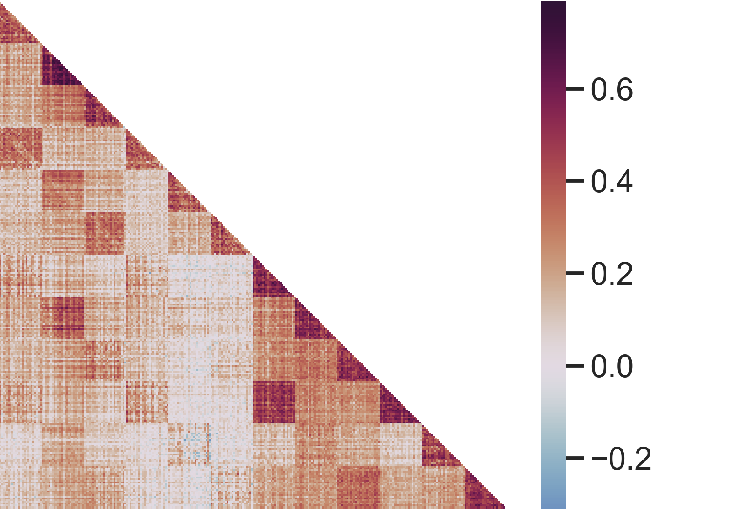
Emotional selectivity = CS+_{ERS} – CS-_{ERS}
Healthy - dACC
Encoding
Fisher Z(correlation)
Retrieval
Encoding
Retrieval
Notes:
Heres what the matrix looks like for real data, this is taken from our healthy subjects in the dACC.
As you can see, there is a lot of structure to this data, but again what we are interested in is this diagonal right here, comparing item to item from encoding to retrieval.
The last piece of this analysis is that we are interested in looking at emotional selectivity of this reinstatement, that is, where is reinstatement greater for CS+ items than CS-.
So we extract those values from each subjects similarity matrix, and take the difference of CS+ and CS- items that were encoded in the same phase, for our two ROIs.

Slide 10
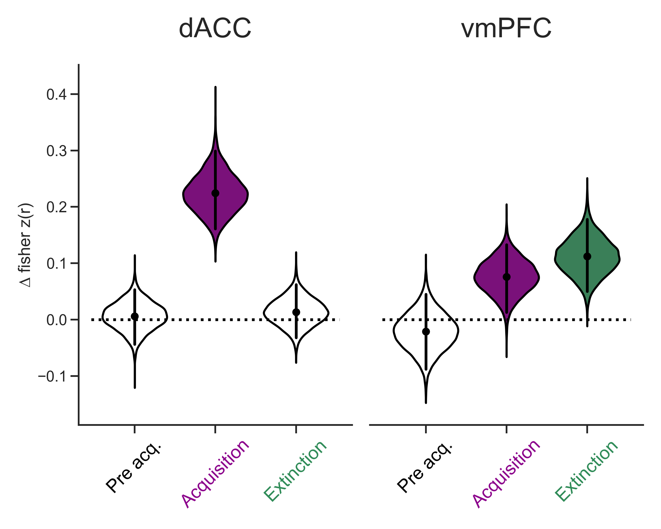
Emotional selectivity = CS+_{ERS} – CS-_{ERS}
Healthy
***
*
***
**
**
p < .05 * p < .01 ** p < .001 ***
FDR corrected within group
Notes:
Here is that data.
The point and bars correspond to the mean and 95% confidence interval, and the violin is showing a bootstrap distribution of the difference, or distribution of the effect size.
So there is no significant emotional selectivity of reinstatement for baseline, which is good, since there was no emotional association when these items were encoded.
Looking at fear acquisition, we see that there is significant emotional reinstatement of fear memories in the dACC. And then looking at extinction, again there is no difference between CS+ and CS- reinstatement.
Looking at the vmPFC, again we see no significant emotional selectivity for reinstatement from baseline, we see some significant reinstatement for fear acquisition, and importantly significant emotional reinstatement for extinction memories.
If we compare across these two regions, we see that acquisition reinstatement is higher in the dACC, and extinction reinstatement is higher in the vmPFC.
This is exactly what we predicted, dissociable reinstatement of memories across these two regions

Slide 11
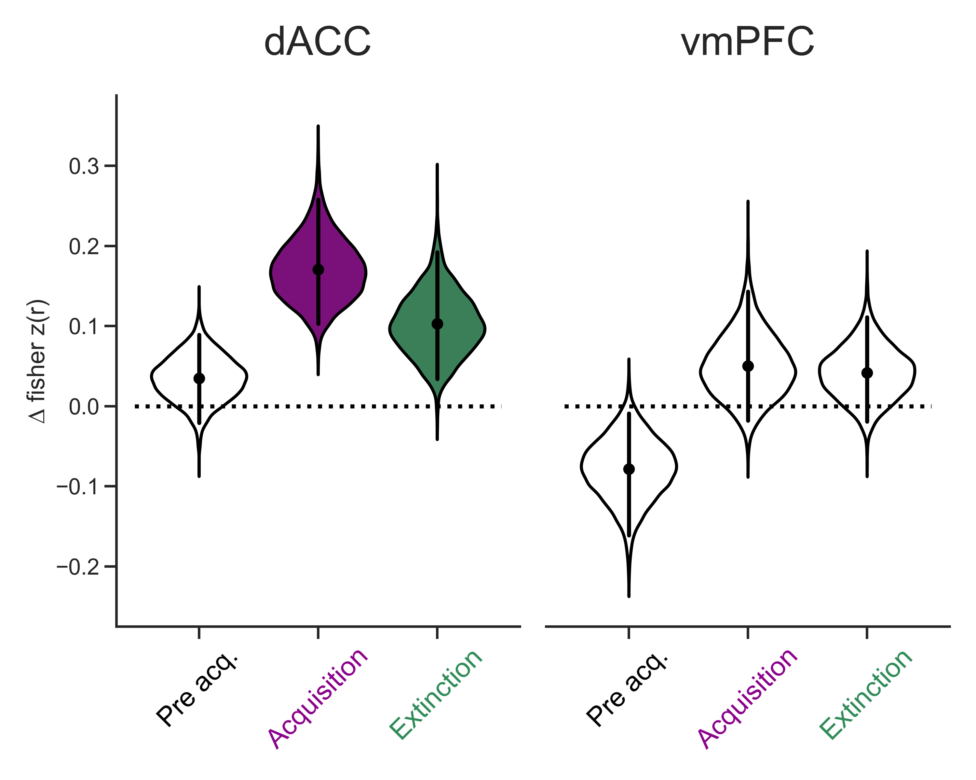
Emotional selectivity = CS+_{ERS} – CS-_{ERS}
Healthy
PTSD
*
***
*
*
***
***
p < .05 * p < .01 ** p < .001 ***
FDR corrected within group
Notes:
(A > E in healthy dACC)
Next, lets look at the PTSD group. In the dACC, again we see no difference for baseline, and significant emotional reinstatement for acquisition. However, we also see significant emotional reinstatement of extinction memories in the dACC for the PTSD group.
In the vmPFC, we see no significant emotional reinstatement at all for either acquisition or extinction. There is something going on with baseline here, however this isn’t as interesting as the lack of reinstatement of extinction. Comparing across ROIs in the PTSD group, we see that fear reinstatement is stronger in the dACC.
So in PTSD, we have what looks like a misallocation of extinction memories to the dACC, they are being reinstated in a brain region that normally codes for fear.
But what about other regions that are canonically associated with fear and extinction processing?

Slide 12
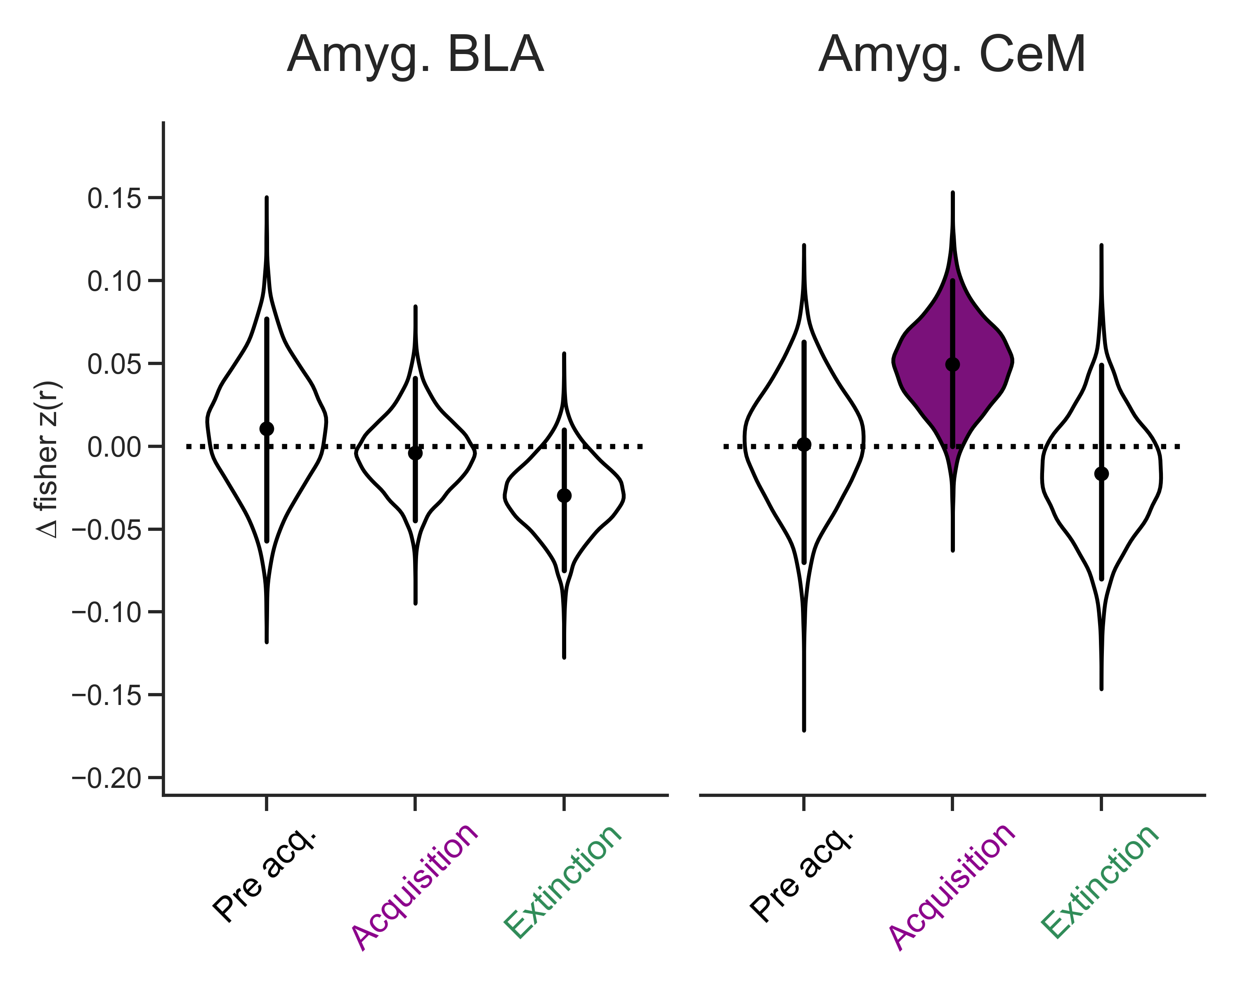
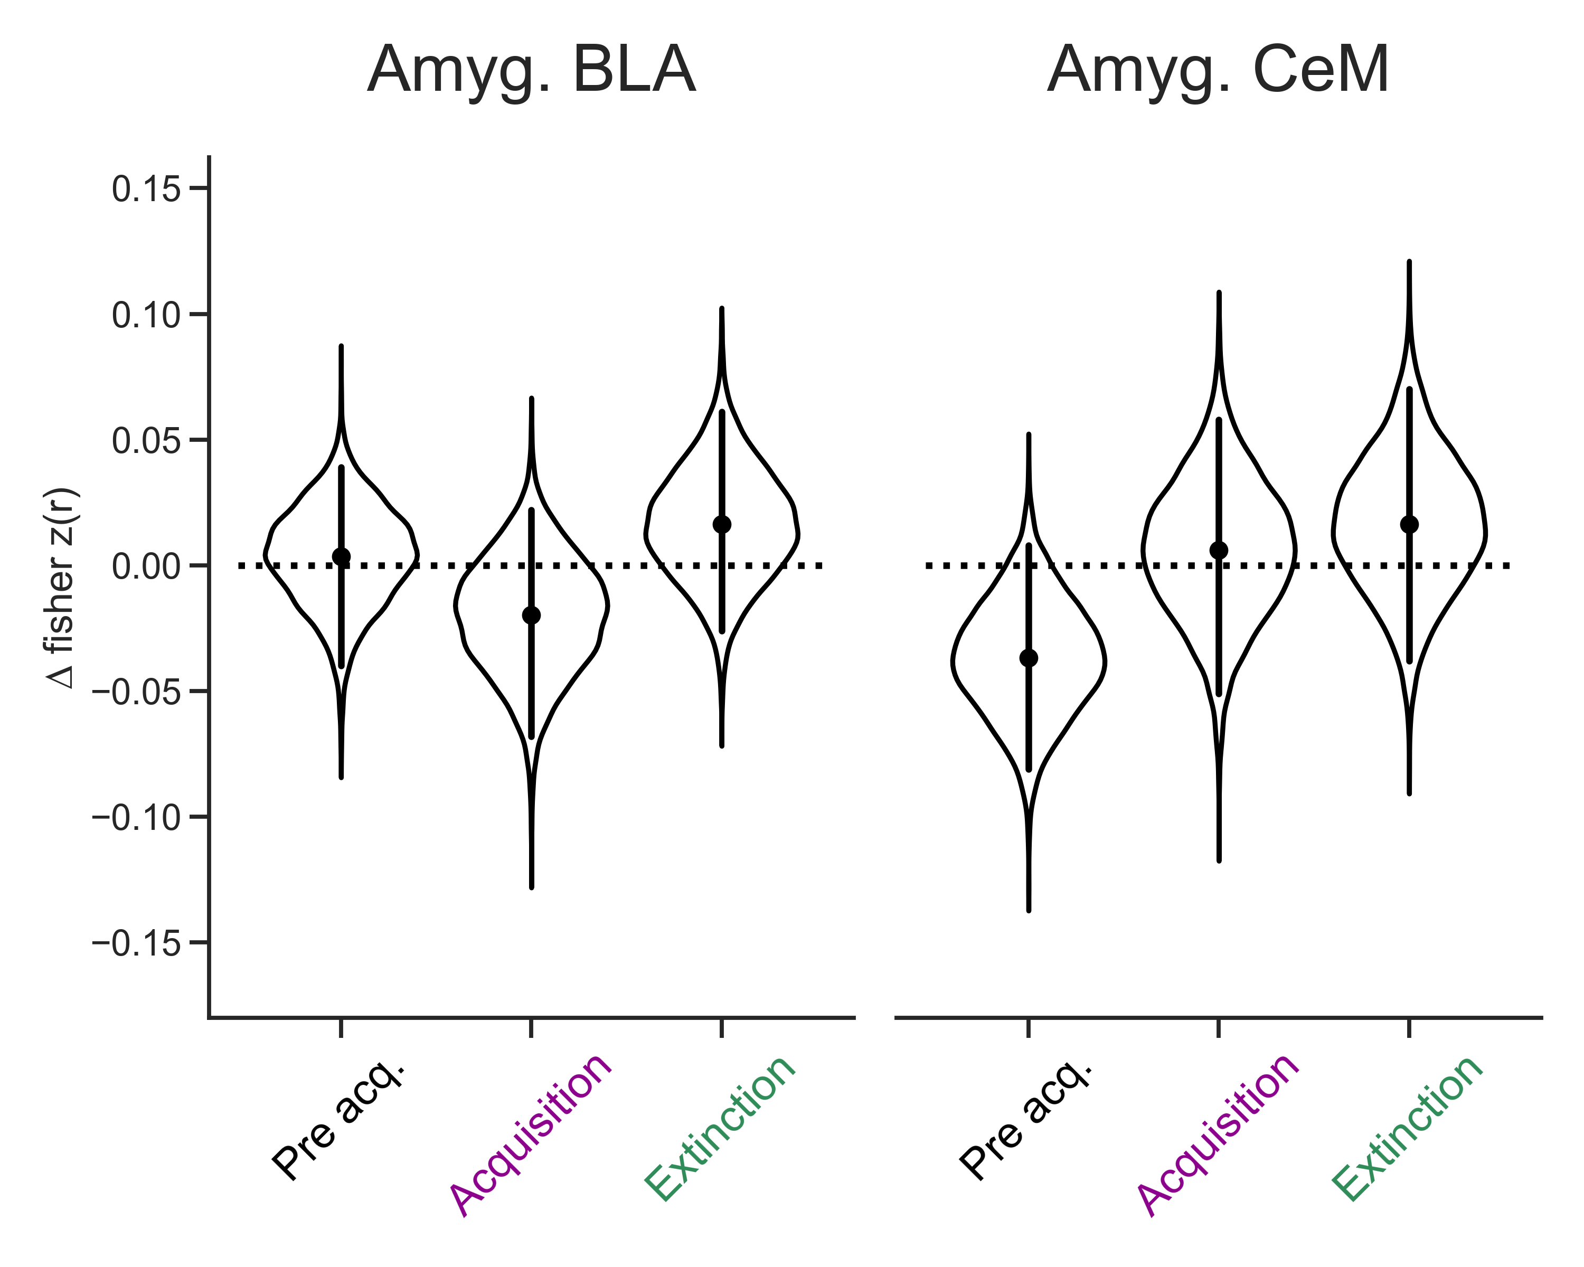
Fear and extinction processes depend on wider circuit
Hippocampus segmented along the long axis (head, body, tail)
No significant CS+ > CS- reinstatement in any hippocampal ROI
Amygdala (BLA, CeM)
Healthy
PTSD
~
~ p < .05 before FDR correction
Notes:
We know that fear and extinction processes depend on o wider circuit, including the amygdala and hippocampus.
So we looked for reinstatement in these regions.
In the hippocampus, we know from work in rodents that the dorsal and ventral segments of the hippocampus may have different functional roles in the control of fear and extinction, so we performed automatic hippocampal segmentation of the into the human equivalent of head/body/tail.
However, we did not observe any significant CS+ > CS- reinstatement in any of these regions. A null result, but I’m sure someone was wondering about it.
So moving onto the amygdala, which we again segmented into subregions, the basolateral and central nucleus
And for the most part this again was a null result, however there was weak reinstatement of fear memories in the central nucleus, for healthy adults only.
I say weak because this does not survive multiple comparisons corrections. However this data does make some sense in terms of the role of the central nucleus in controlling the output of fear. That being said, its interesting that were only seeing this in the healthy adults. Just a reminder that this metric is not a measure of neural activity during the memory test, but rather its the measuring the degree of pattern similarity from encoding to retrieval. So one of the reasons we could be seeing this in healthy adults and not PTSD is that the healthy are discriminating better between the fear CS+s and CS-s during the retrieval test.

Slide 13
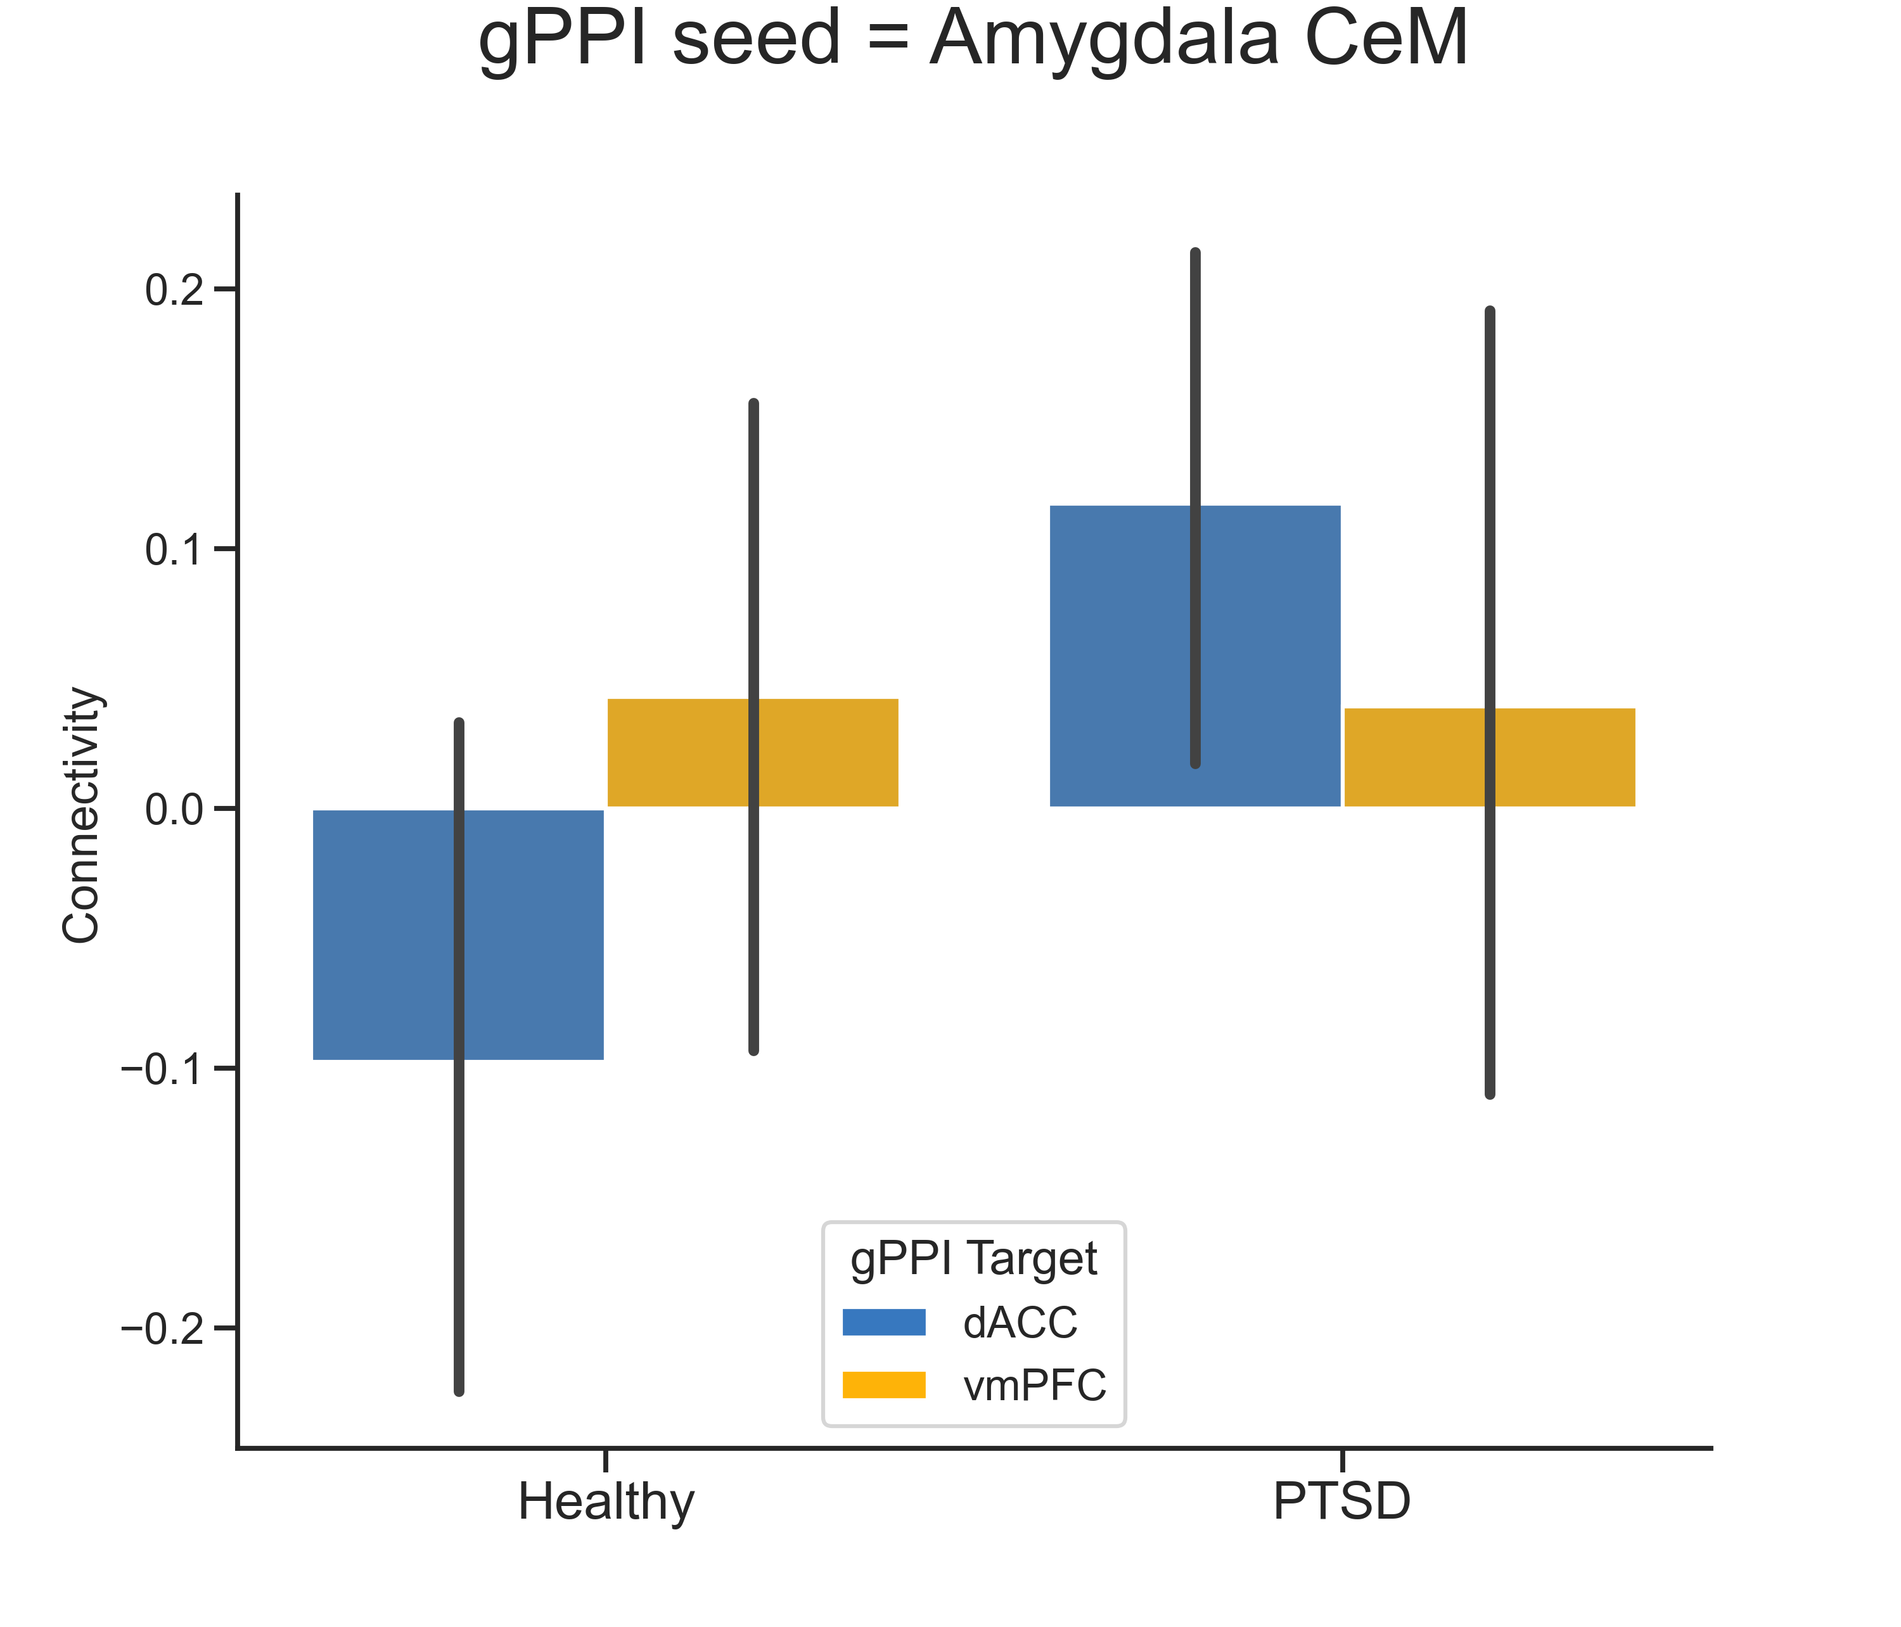
Amygdala CeM output controls fear expression
*
*
Functional connectivity (gPPI)
Extinction CS+ - Acquisition CS+
Mean +/- 95% CI
p < .05 *
Notes:
As a next step, we wanted to investigate how the central nucleus is functionally connected to the PFC, during the memory retrieval test. As we know those are important projections.
In order to probe functional connectivity in fMRI we used gPPI, or generalized psychophysical interaction. This is a way to model task based functional connectivity using a time-course from seed region and looking for co-activations in target regions. With this measure there are no absolute values of connectivity, it all has to be relative to another condition. So in this case, we wanted to see how central nucleus amygdala functional connectivity differs between extinction CS+ and fear acquisition CS+. For this analysis, we are only using neural data from the retrieval test, when participants are encountering these stimuli in a neutral emotional context.
So in the healthy adults, we see that there is no difference between extinction CS+ and acquisition CS+ connectivity in either the dACC or vmPFC – so there is no difference in connectivity between these two conditions during the retrieval test
However, in the PTSD group, we see that the central nucleus is showing preferential connectivity with the dACC for extinction CS+s. That is, the amygdala and dACC are more connected when subjects encountered the CS+s from extinction compared to the CS+s from acquisition.
Comparing across groups, we see that this connectivity is significantly stronger in the PTSD group compared to the healthy group.
One possible interpretation of this data is that in the PTSD group the central nucleus is treating the extinction CS+ stimuli as novel threatening stimuli, and signaling a fear response.

Slide 14
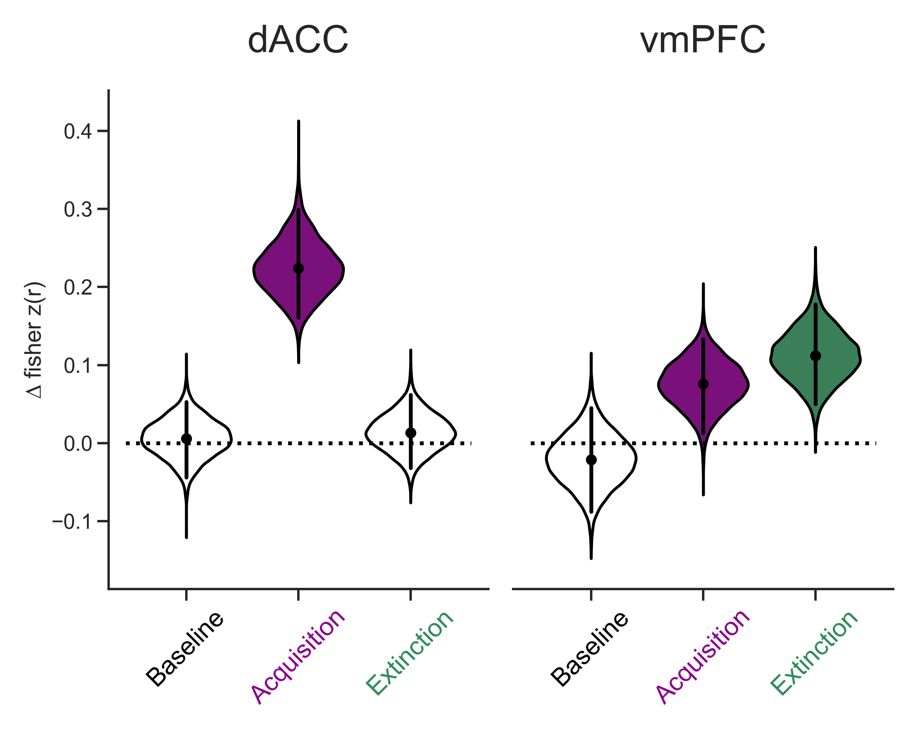
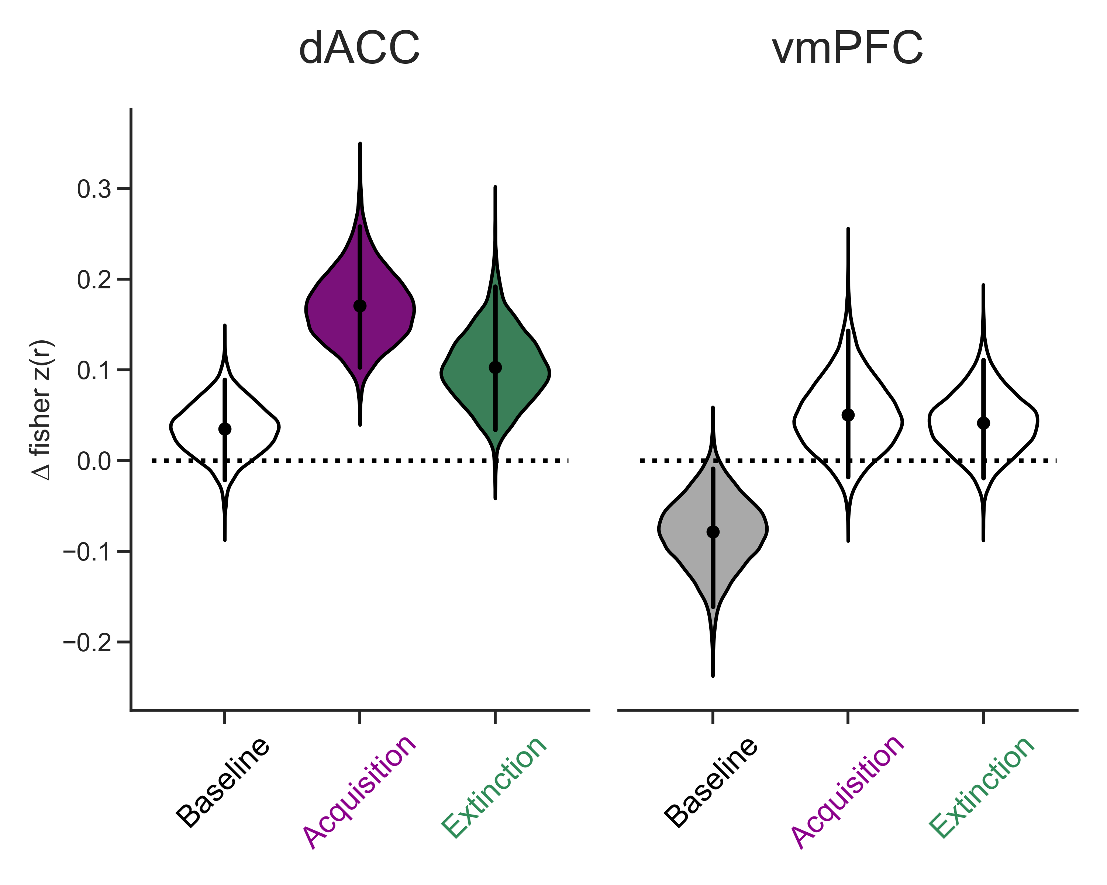
***
***
Dissociable reinstatement in PFC of emotional memories in healthy adults - encoding specificity
***
*
Individuals with PTSD misallocate
extinction memories to dACC
*
Extinction CS+ - Acquisition CS+
Individuals with PTSD show increased amygdala-dACC connectivity for extinction memories
Healthy
PTSD
Notes:
That isn’t all of the data I’m going to share with you today, but I wanted to do a quick summary before we move on to more exploratory analyses. So in summary, in healthy adults we observed dissociable reinstatement of fear and extinction in the PFC. Fear high in the dACC, extinction high in the vmPFC.
In contrast, for individuals with PTSD, we observed significant reinstatement of both fear and extinction memories in the dACC.
Finally, we saw that individuals with PTSD show increased amygdala-dACC connectivity for extinction memories, relative to acquisition.

Slide 15
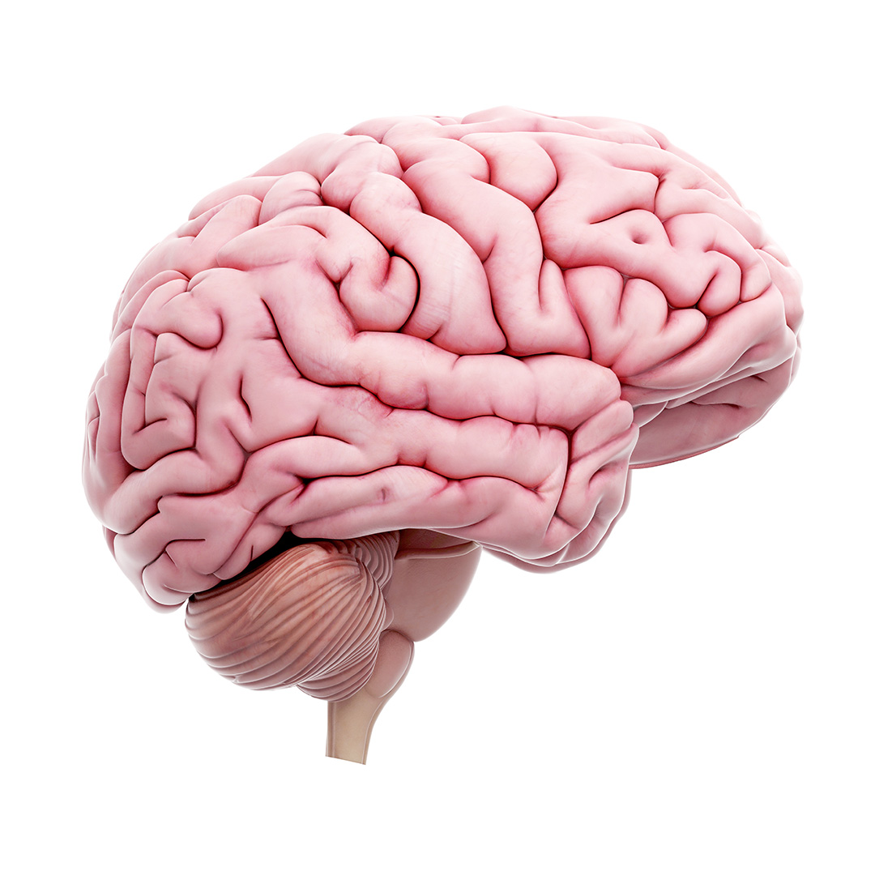
Exploratory whole brain analysis – searchlight
Searchlight radius = 6mm
Calculate emotional reinstatement at each location in the brain
Restricted statistics to voxels >=50% grey matter probability
FDR cluster correction: activation threshold of P < 0.001, and cluster threshold P < 0.05
No significant sub-cortical clusters
Notes:
So we’ve gone though our major a priori ROIs in the PFC, and subcortical ROIs, but one advantage of fMRI data is that we capture whole brain activity, something that you can’t really do in rodent models.
We can take advantage of that by looking for brain regions that show this emotionally selective reinstatement for fear and extinction memories. In order to do this, we take a sphere of voxels, and iteratively move it over the whole brain. At each location, we compute our relevant measure, in this case CS+ - CS- reinstatement, and assign the score to the center voxel. We repeat this for every sphere in the brain, and then perform whole brain statistics to correct for multiple comparisons. We first limit our analysis to voxels that have 50% probability or higher of being grey matter, and then we perform cluster correction to screen for significant voxels.
And just as before, in any of the contrasts there were no significant sub-cortical voxels, so the data I’m about to show you will just be looking at cortex

Slide 16
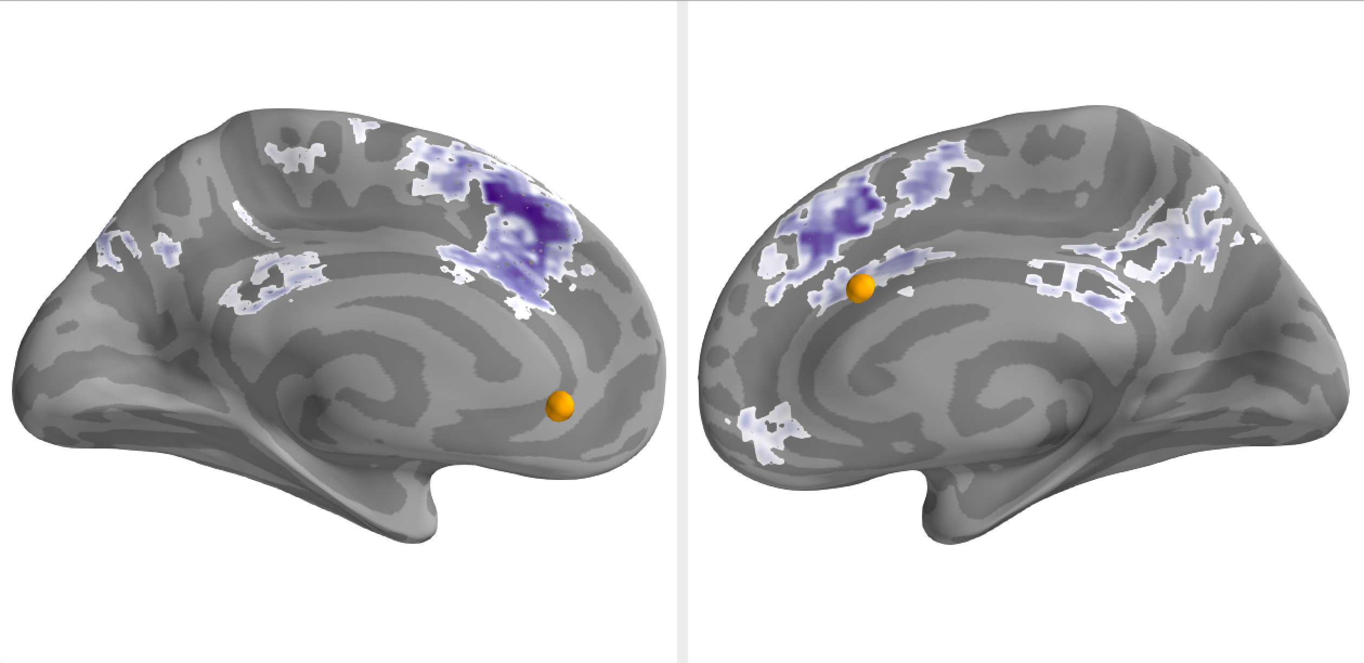
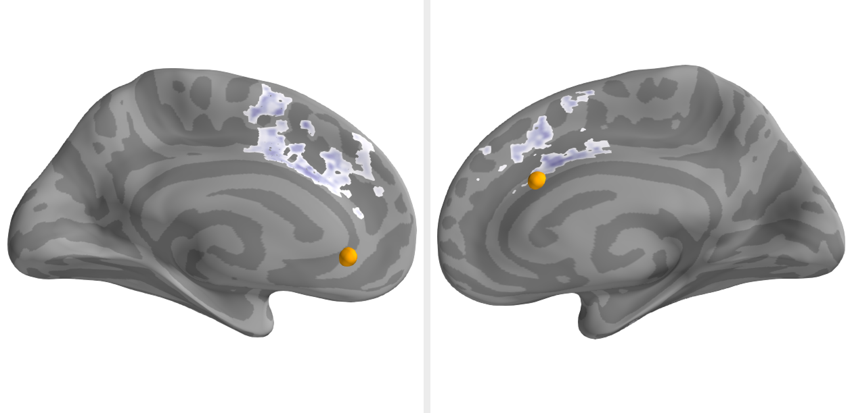
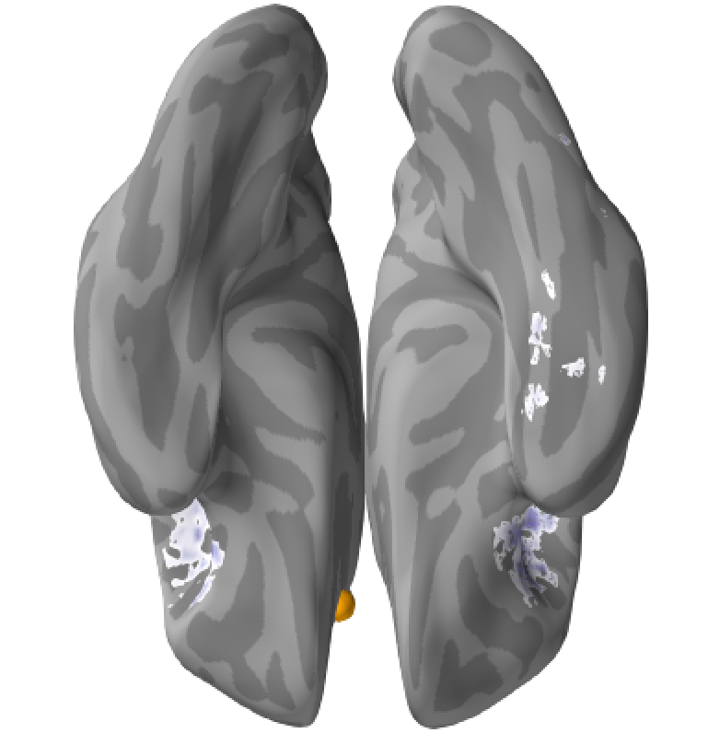
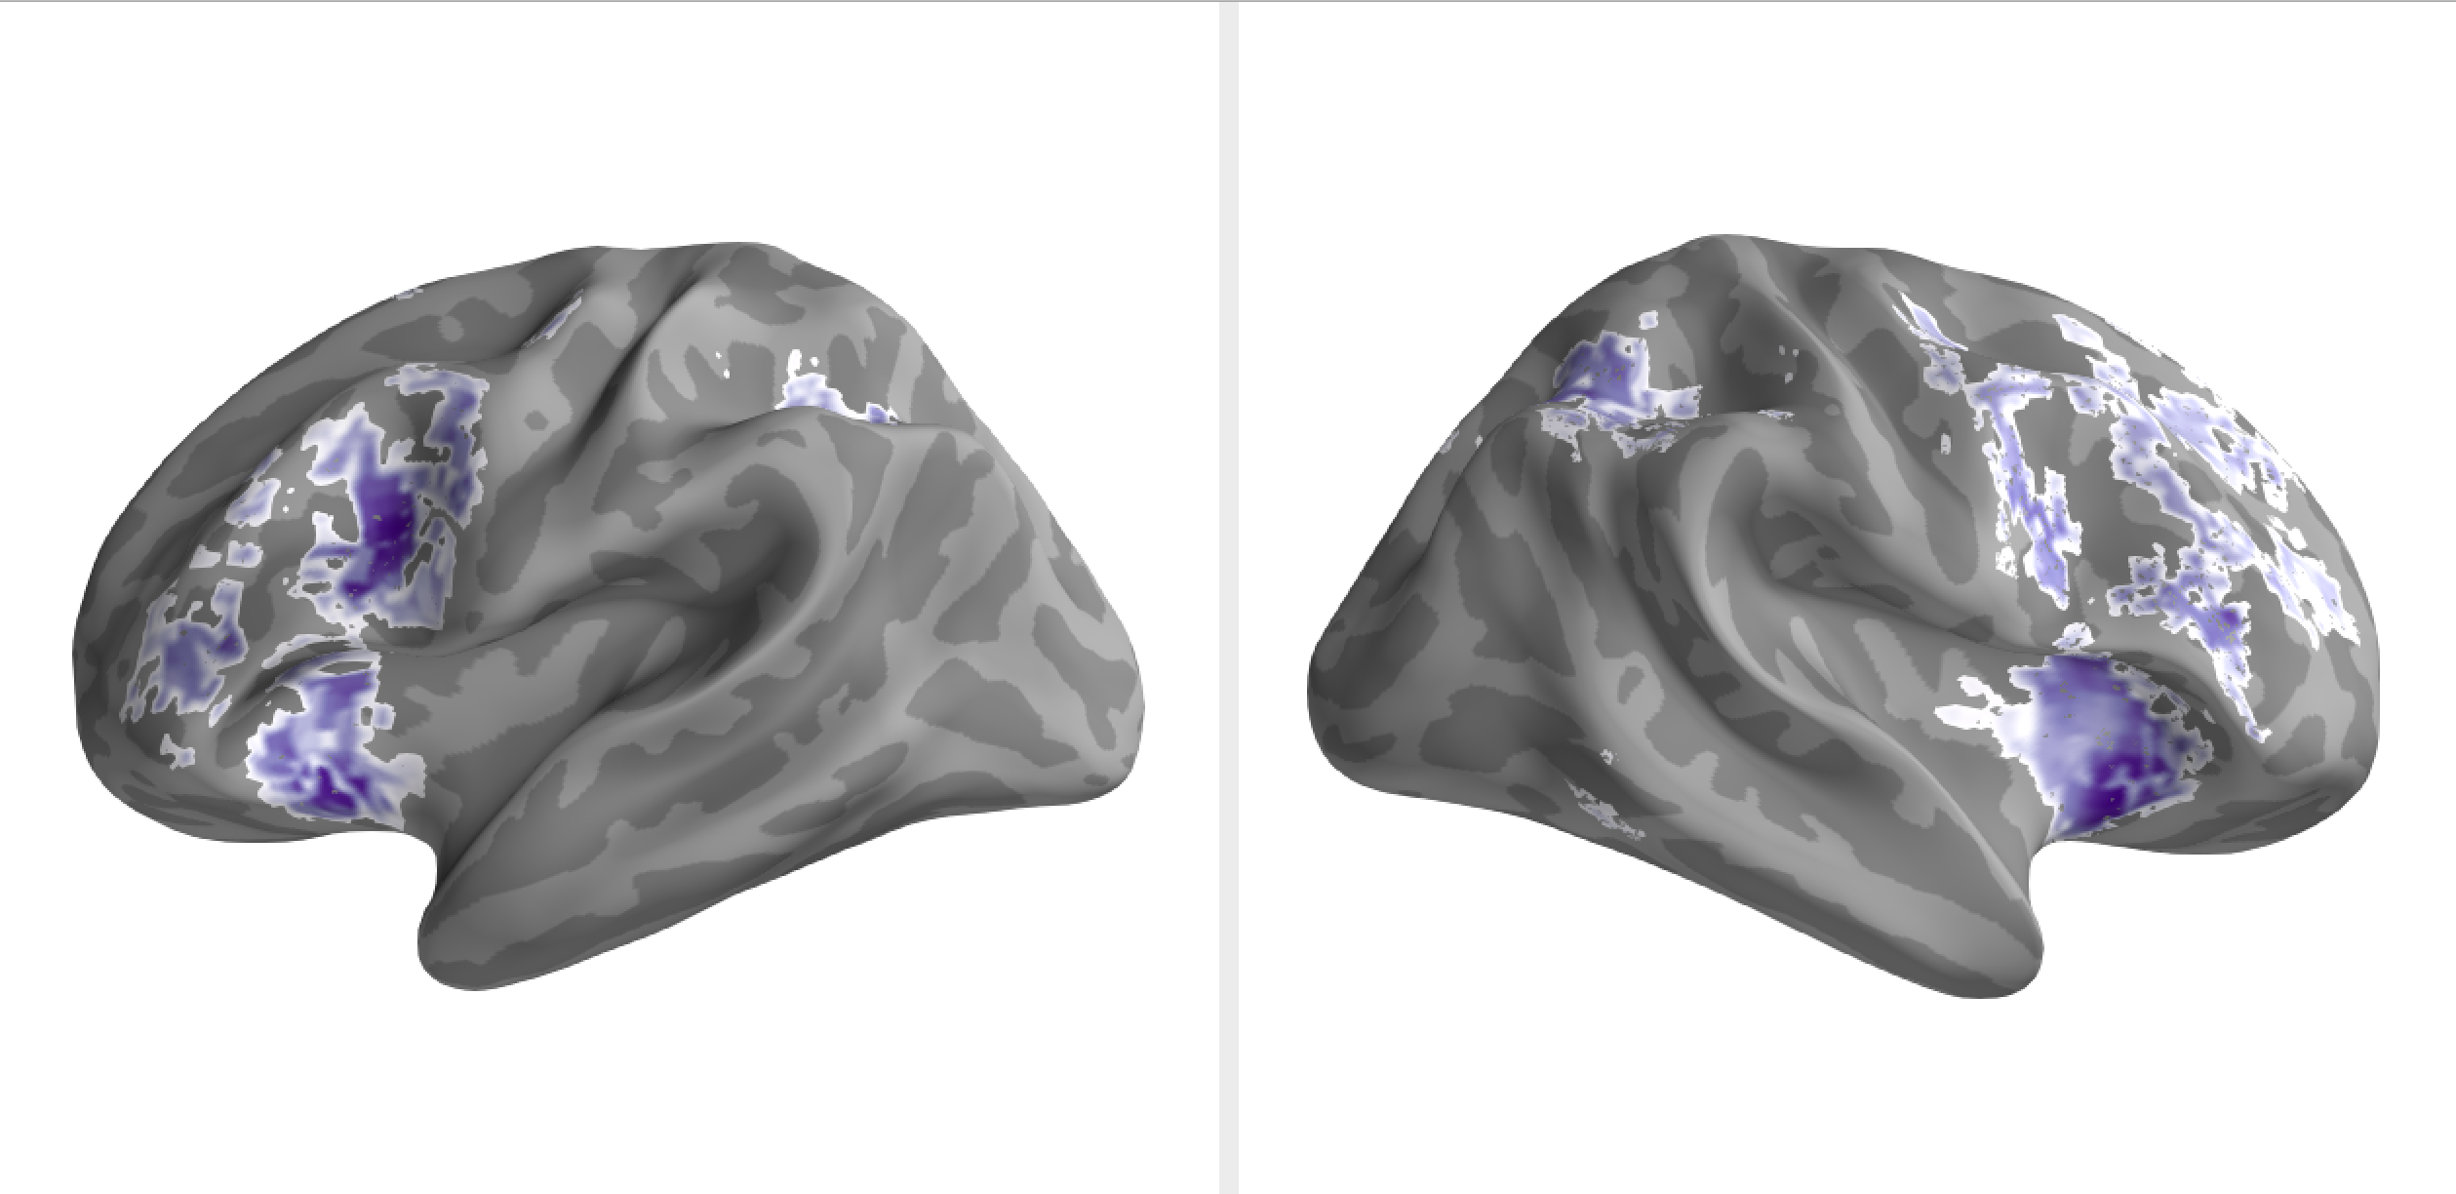
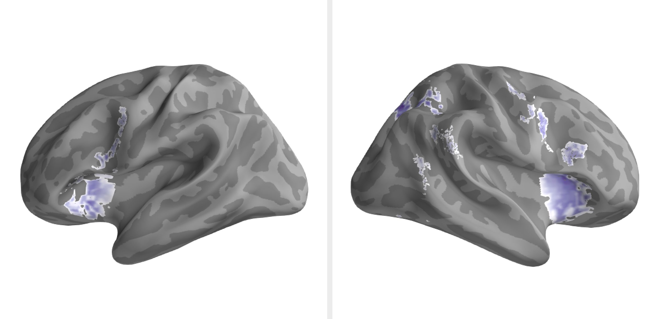
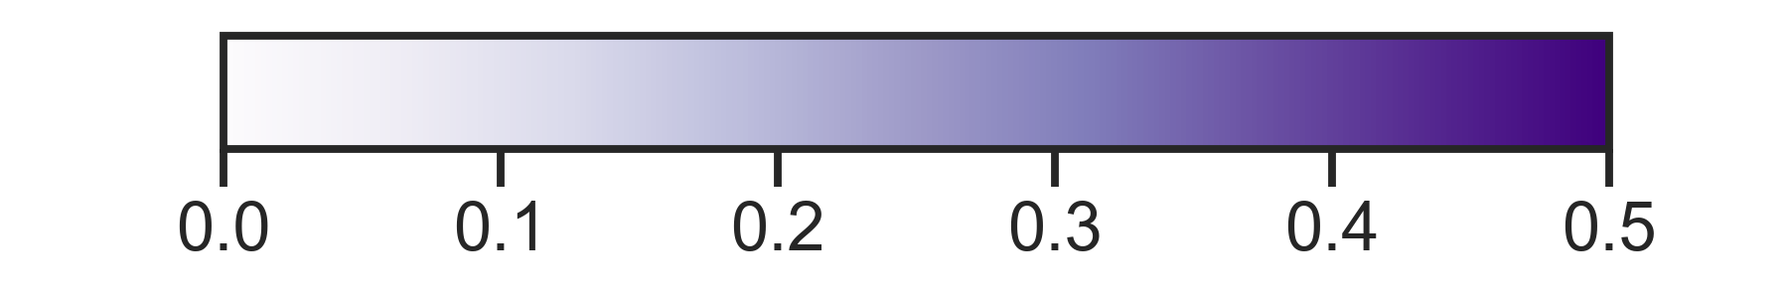
Healthy
PTSD
_{Fear acquisition}
_{Fear acquisition}
Emotional reinstatement (CS+ > CS-)
Notes:
Explain the dots and why they are only on one side
Healthy acq:
Medial: dACC, vmPFC Brodmann area 32, posterior cingulate/precuneus
Where is the dACC?
Lateral: Medial frontal and superior frontal Brodmann area 8, anterior insula, and superior parietal lobe
Then moving onto PTSD, the largest cluster is in the dACC, however unlike the healthy adults were not seeing any posterior cingulate or precuneus
On the lateral side its more similar to the healthy adults, we again see lots of middle front and superior frontal gyrus, as well as bilateral insula, and again some unilateral superior parietal lobe
And then finally probably one of the cooler results for fear acquisition, is that in the PTSD group we also find a cluster in parahippocampal cortex. Again these analyses are exploratory, but we know that the hippocampus plays a crucial role in regulating the return of fear so this parahippocampal makes me think about reinstating contextual details of fear memories.
So this is all reinstatement of fear acquisition, now let’s look at extinction

Slide 17
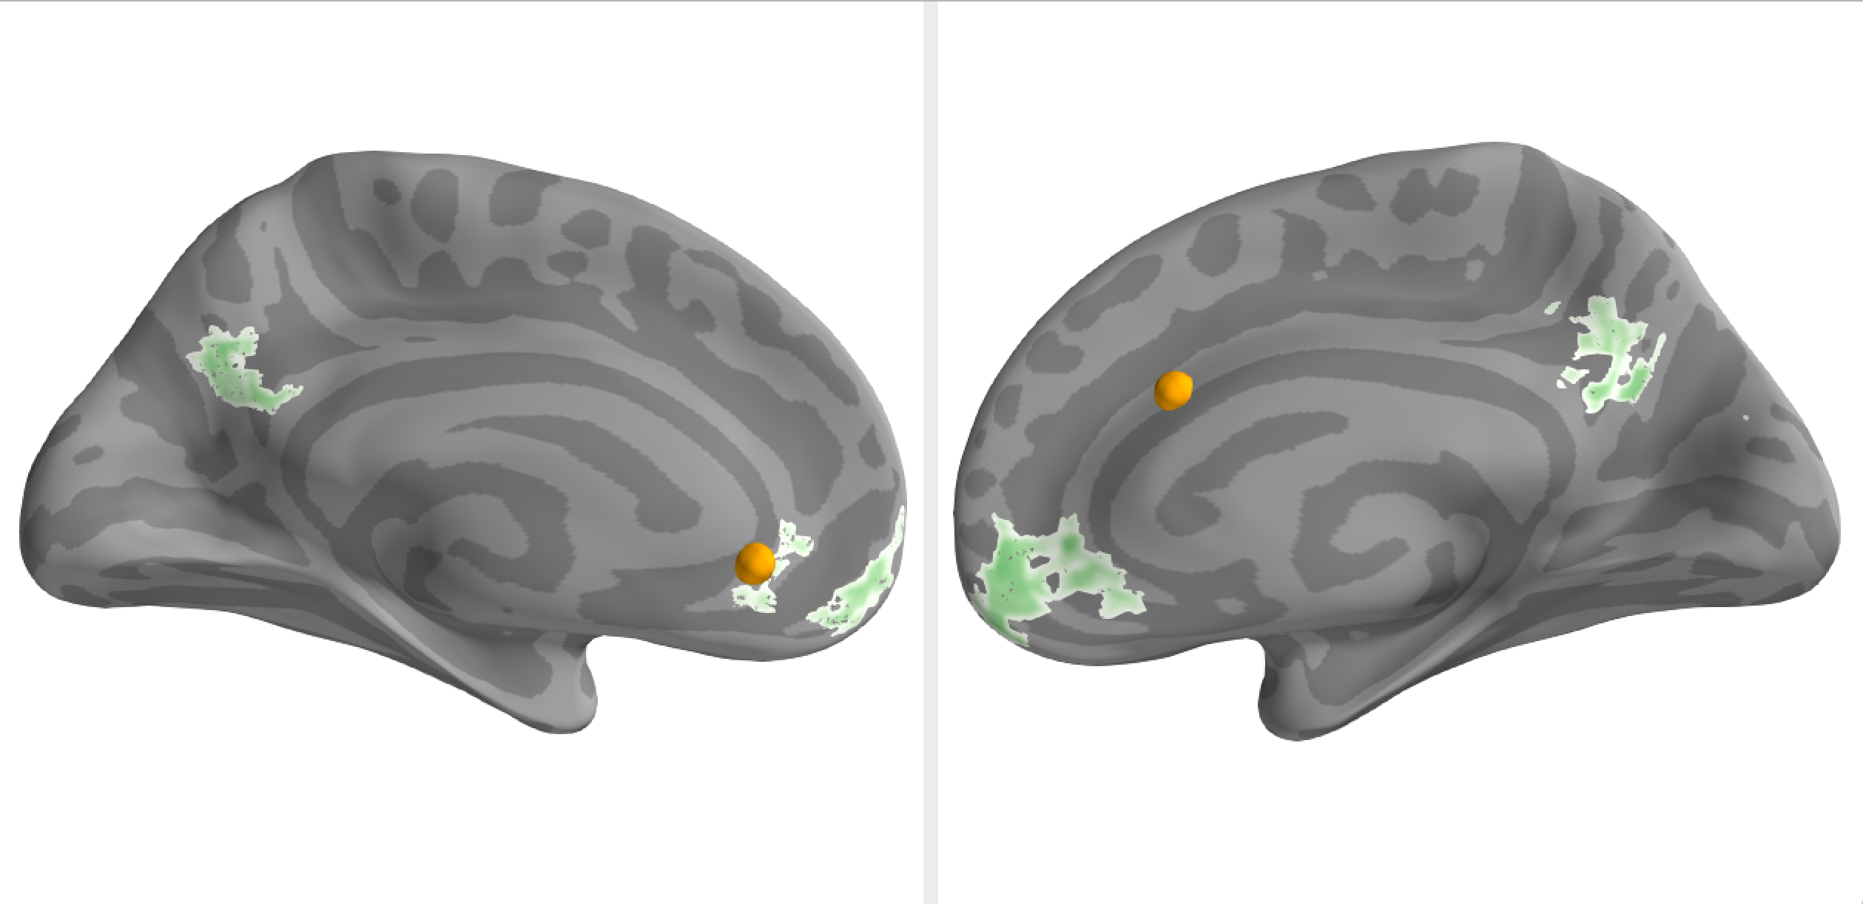
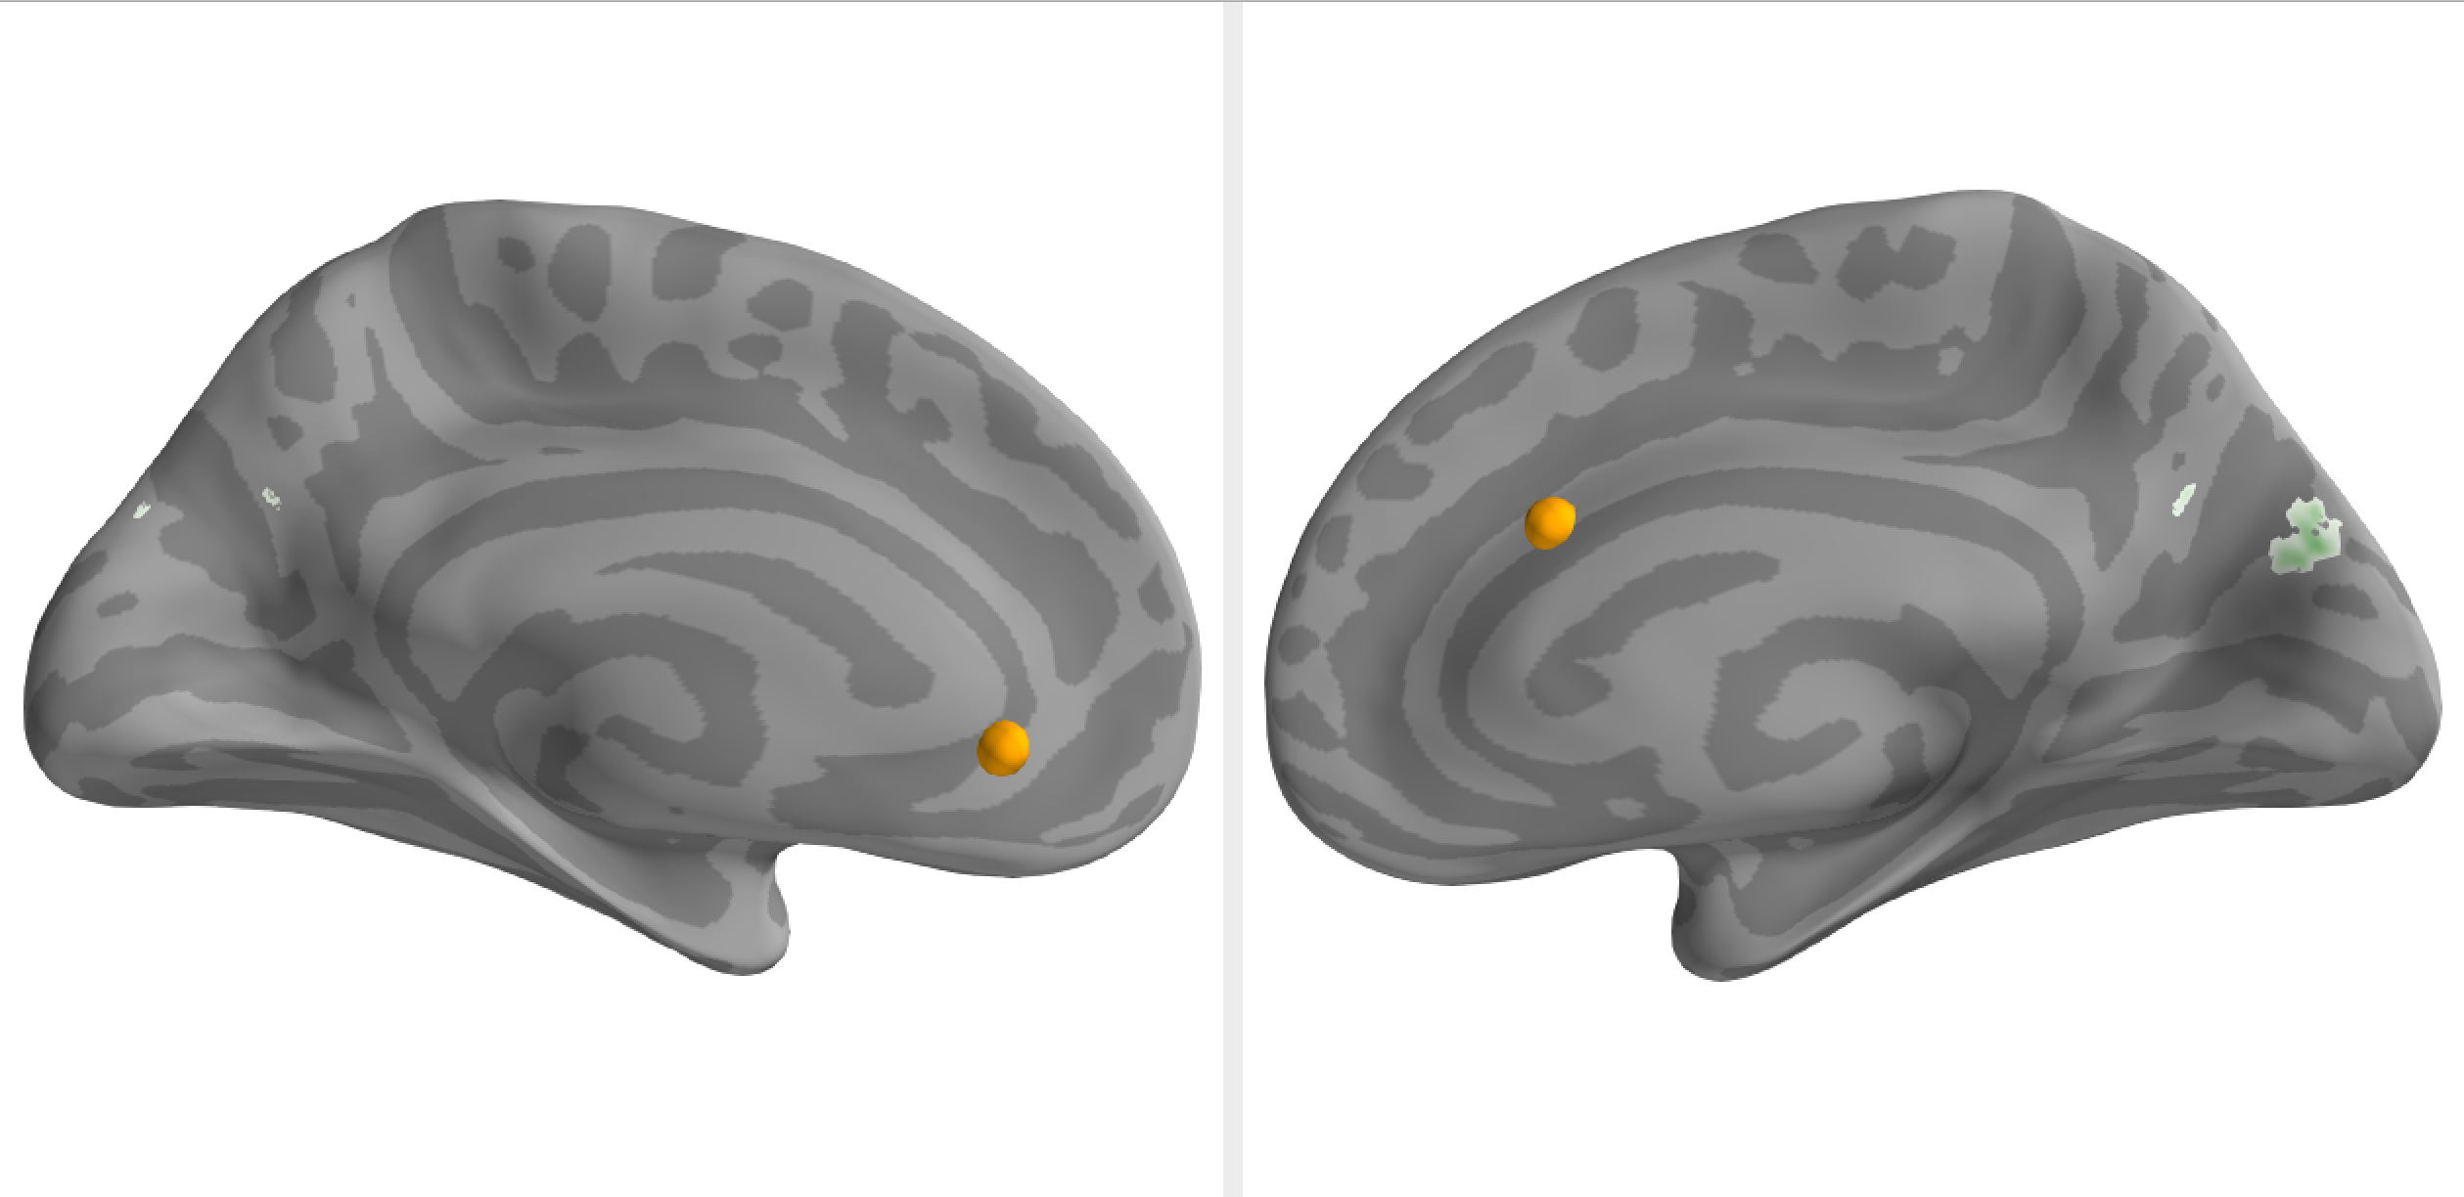
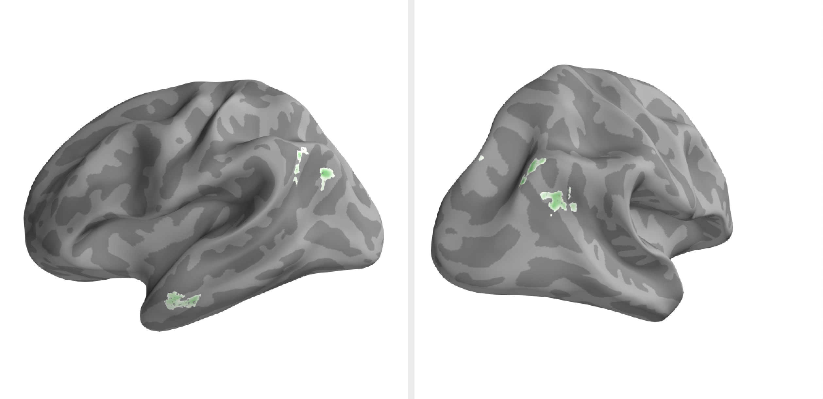
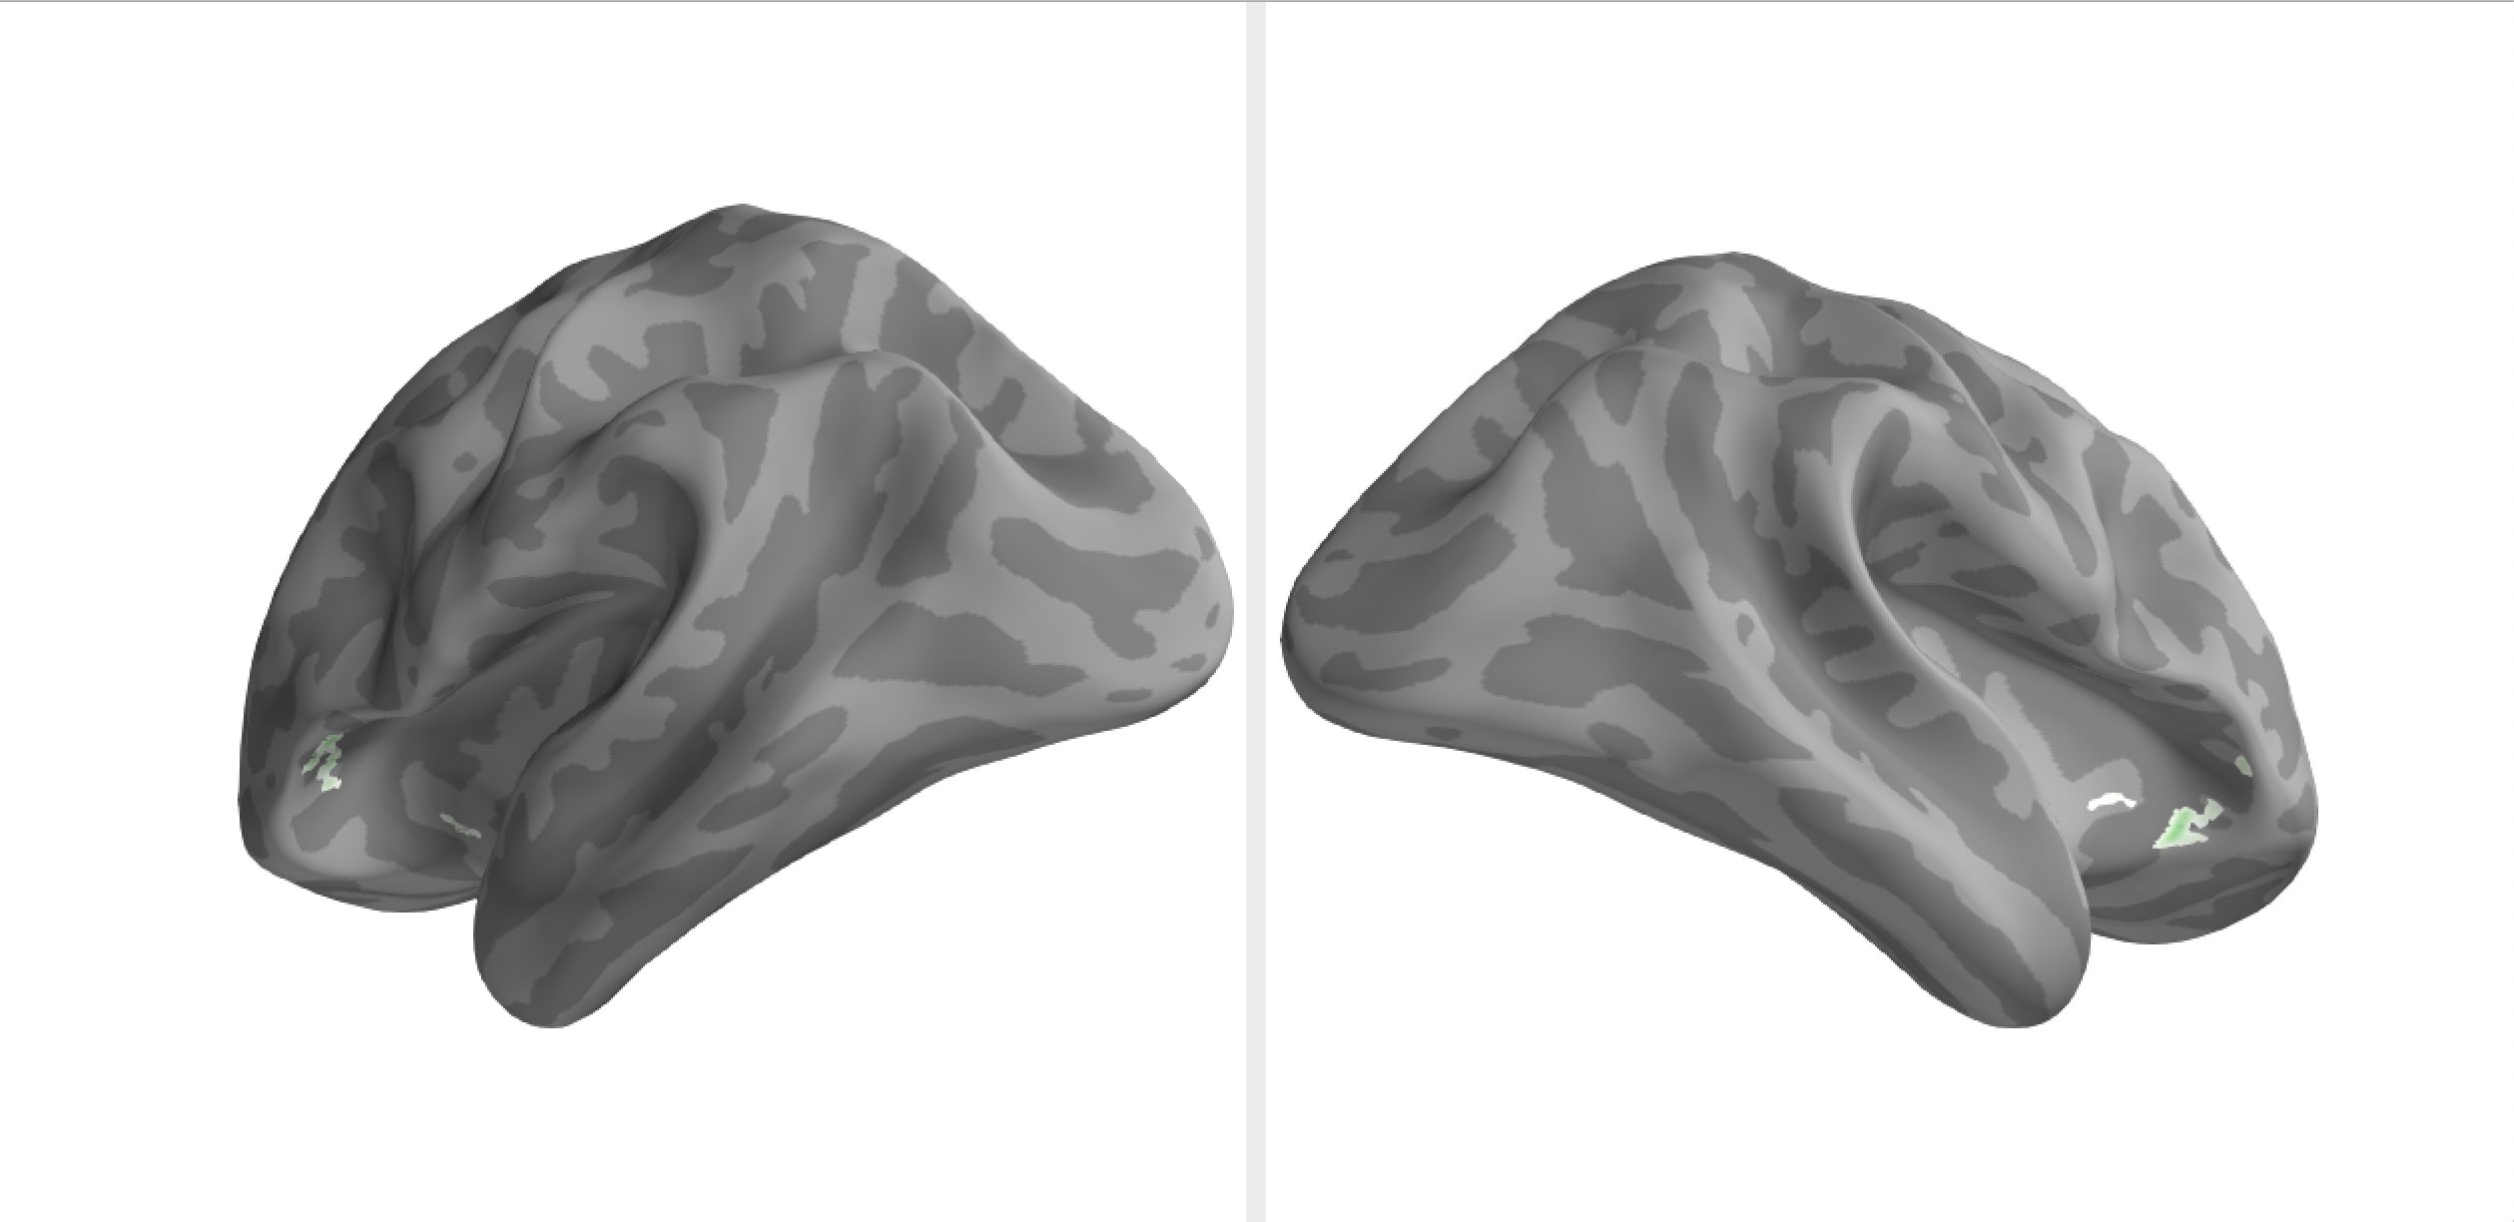
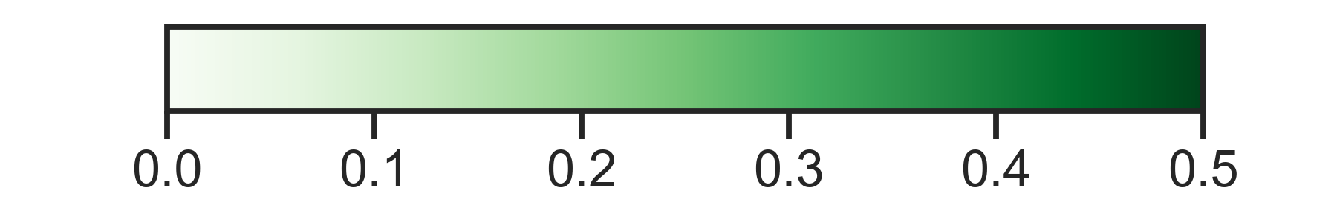
Healthy
PTSD
_{Extinction}
_{Extinction}
1
1
Emotional reinstatement (CS+ > CS-)
Notes:
As to be expected for the healthy adults, the largest cluster of extinction reinstatement is in the vmPFC, around Brodmann areas 10 and 32, and interestingly again as with fear we see reinstatement in posterior cingulate and the precuneus
On the lateral surface we find clusters in the angular gyrus, with together with the medial clusters represents the DMN. And finally there was one cluster in the anterior temporal gyrus.
And then looking at PTSD, we see no extinction reinstatement in the medial PFC. And so if you’ve been playing close attention you might notice that we aren’t seeing any dACC here even though we did see significant extinction reinstatement in our a prior dACC ROI, and one reason why were not seeing that here could be the difference in size between our a priori ROIs and the searchlight spheres
But, we are seeing some extinction reinstatement in the precuneus, like the healthy adults
And finally looking at the lateral sides, what’s really cool is that were seeing significant clusters in the bilateral anterior insula. I’m really excited about these clusters because its another example of individuals with PTSD misallocating extinction memories to a region that is associated with fear, and were not seeing this in the healthy group.

Slide 18
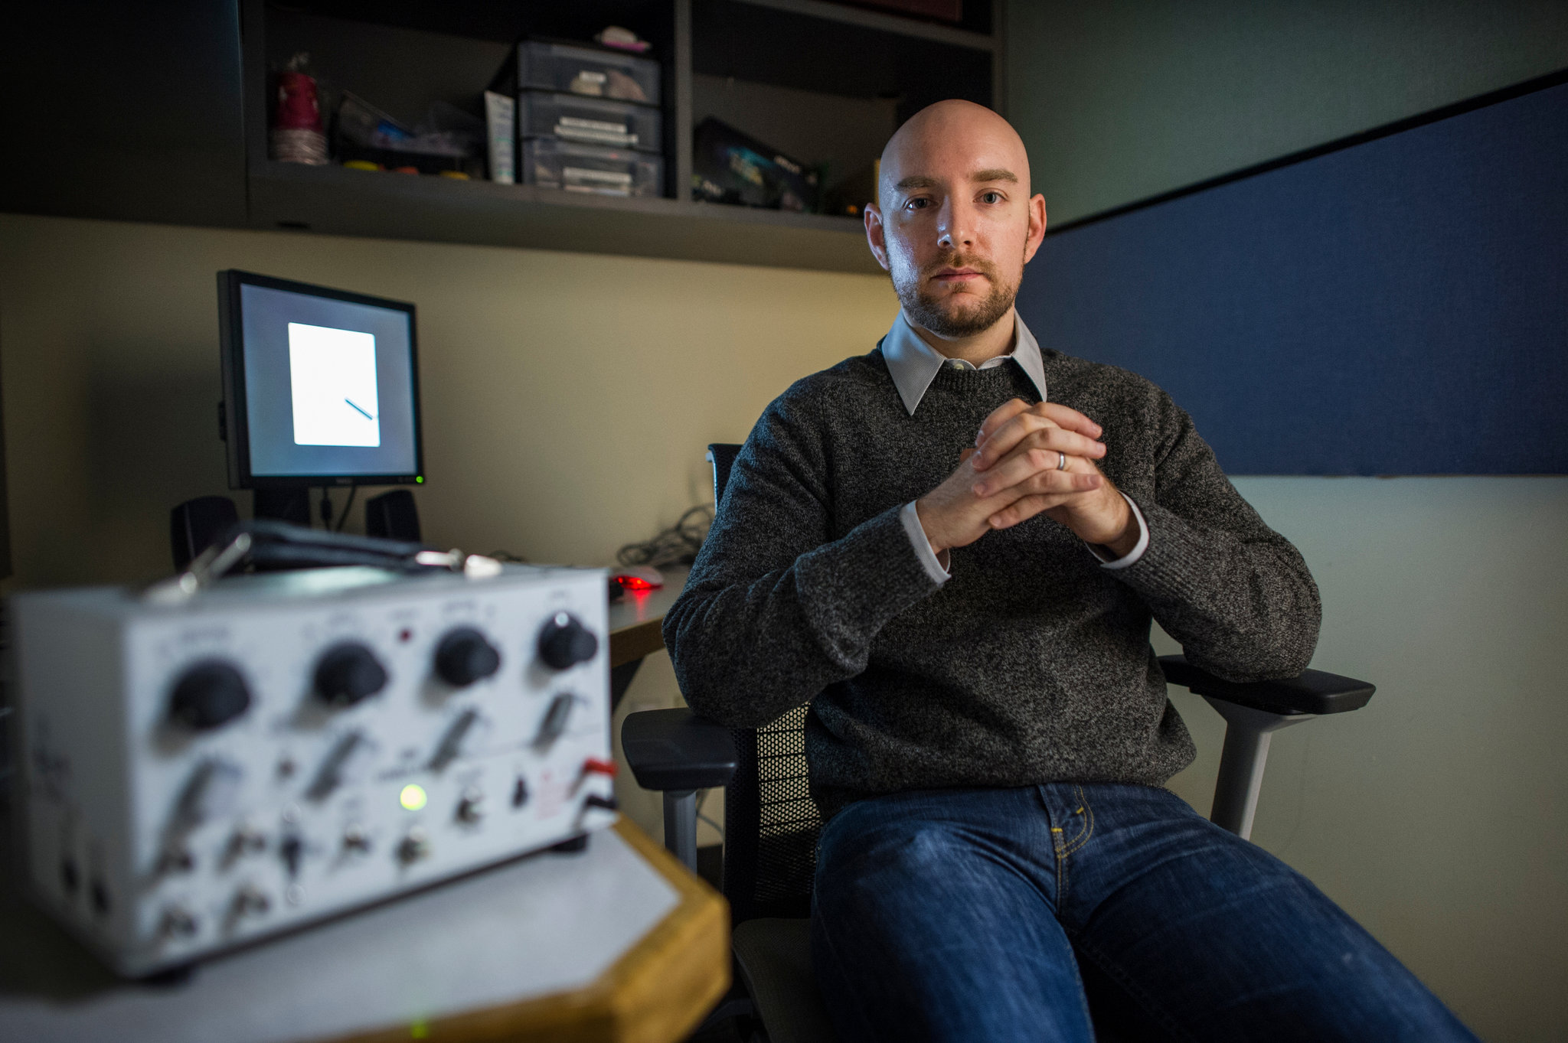



NIH R00MH106719 - Dunsmoor
NIH F31MH124360 - Hennings
achennings.github.io

Slide 19
***
***
Dissociable reinstatement in PFC of emotional memories in healthy adults - encoding specificity
***
*
Individuals with PTSD misallocate
extinction memories to dACC
*
Extinction CS+ - Acquisition CS+
Individuals with PTSD show increased amygdala-dACC connectivity for extinction memories
Healthy
PTSD
Notes:
So in summary, in healthy adults we observed dissociable reinstatement of fear and extinction in the PFC. Fear high in the dACC, extinction high in the vmPFC.
In contrast, for individuals with PTSD, we observed significant reinstatement of both fear and extinction memories in the dACC.
Finally, we saw that individuals with PTSD show increased amygdala-dACC connectivity for extinction memories, relative to acquisition.
Really briefly, I’d like to talk about one other interesting result that might help explain whats going on with the PTSD group.

